Slide 1
Introduction to SMTP
RES, Lecture 3
Olivier Liechti

Slide 2

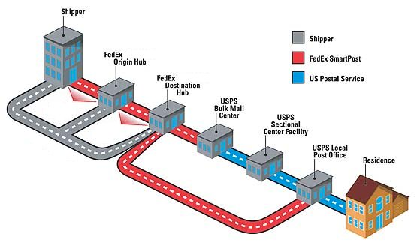

Slide 3
Warning 1
The slides and the webcasts contain examples and demos with real SMTP servers.
The behaviour of these servers may change over time. It may also change depending on the network you are connected to (internal, ISP, other ISP).
The main reason why a server might behave differently is the fight between mail administrators and spammers.

Slide 4
Warning 2
It is a good thing to experiment with real SMTP servers.
But remember that they are real servers and act responsibly.
Please avoid launching a surprise denial of service attack with your accidental infinite loop.

Slide 6
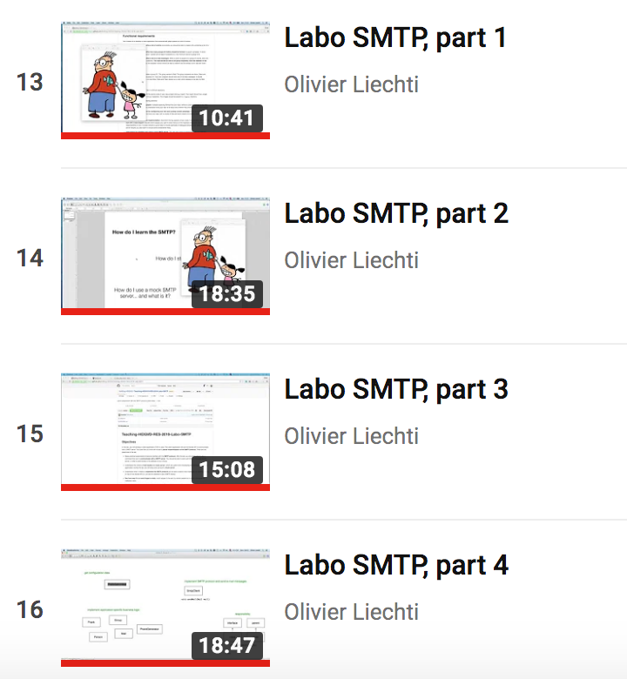
SMTP demo & hints
SMTP protocol
Mock server
Implementation walk-through

Slide 7
Démo (5 minutes MAX)
Le labo est terminé et la démo est faite dans les délais. | 1 pt
Le groupe arrive à démarrer un serveur mock dans un container Docker et à expliquer à quoi il sert. Le groupe a aussi configuré le service mailtrap.io | 1 pt
Le groupe montre comment configurer la campagne de “pranks” et lance son programme dans un environnement de test (mock mock, mailtrap ou autre). Le groupe explique les résultats. La démo ne marche pas: 0 pt! | 2 pt
Le groupe montre son repo GitHub. En regardant les commits, on voit que tout le monde a participé et qu’il n’y a pas seulement un gros commit à la fin. | 1 pt
Une documentation de qualité et conforme aux exigences est fournie dans le repo GitHub. | 2 pt

Slide 8


What happens when Bob wants to send an e-mail to Alice?

Slide 9


Bob uses Thunderbird to write his mail.
Alice uses MS Outlook to check and read her mails.
In the technical specs (RFCs), these programs are called
Mail User Agents (MUA)

Slide 10



Bob uses his professional e-mail address. His company runs a MS Exchange Server.
Alice uses her private address. She has an account (and a mailbox) on the Google gmail infrastructure.

Slide 11
Bob writes a message to “alice.res@gmail.com”. He pushes on the “Send” button.
The Exchange Server is made of 2 logical components: the MSA and the MTA.
Mail Submission Agent (MSA)
TCP/587
Mail Transfer Agent (MTA)
Bob’s MUA asks Bob’s MSA to deliver the mail. It uses the SMTP protocol for that purpose and (should) use TCP port 587.
EHLO
MAIL FROM
RCPT TO
After enforcing usage policies, the MSA delegates the work to the MTA. We don’t know how.
DATA

Slide 12
Mail Transfer Agent (MTA)
Mail Transfer Agent (MTA)
TCP/25
DNS
Bob’s MTA initially does not know where to forward the mail...
Give me the MX record(s) for gmail.com
It issues a DNS query to get a list of MX records for Alice’s domain (gmail.com).
EHLO
MAIL FROM
When Bob’s MTA knows the IP address of Alice’s MTA, it uses the SMTP protocol once more to forward the message. TCP port 25 is used in this case.
RCPT TO
DATA
When Alice’s MTA receives the mail, it stores it in Alice’s mailbox (for later retrieval).

Slide 13
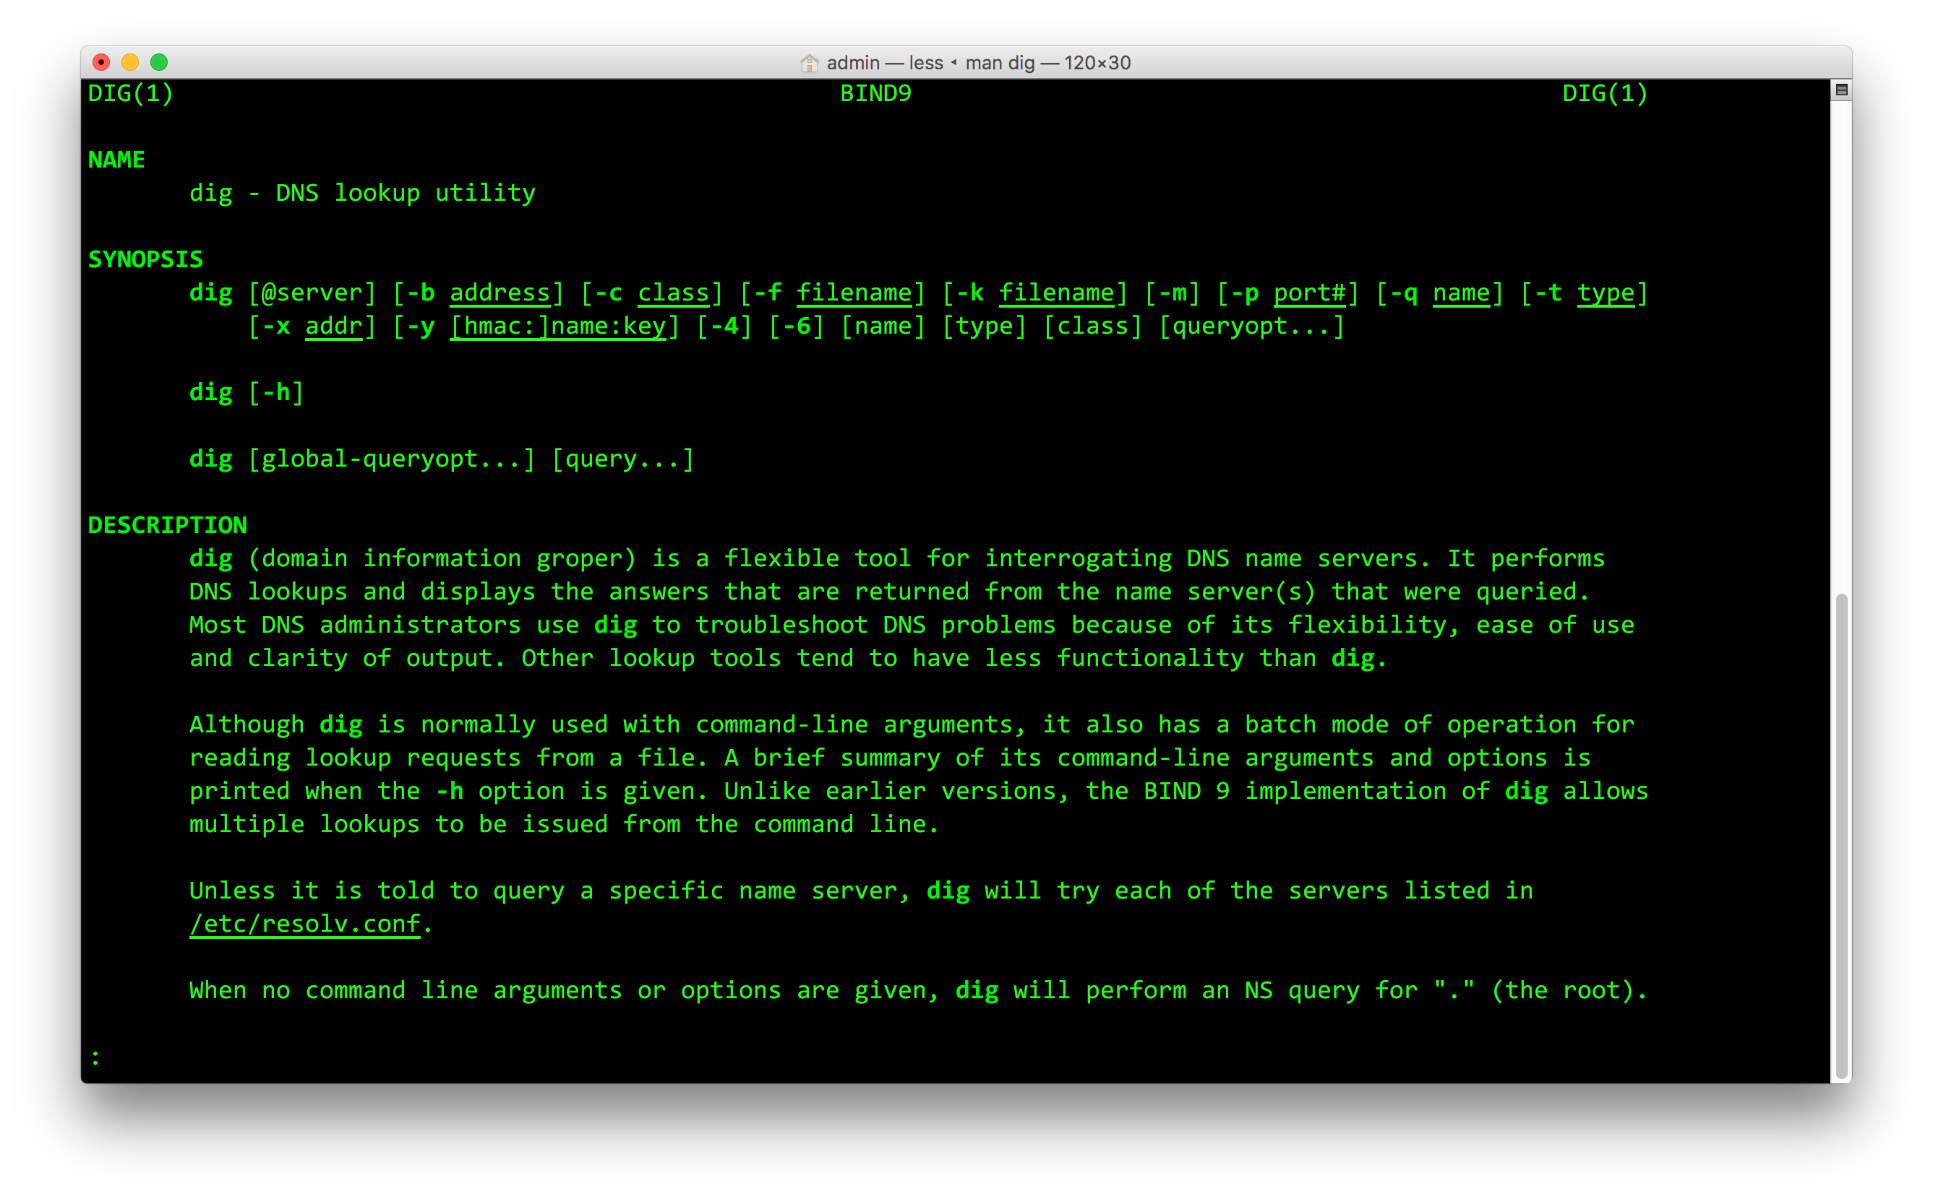
dig
nslookup is another command for querying DNS

Slide 14
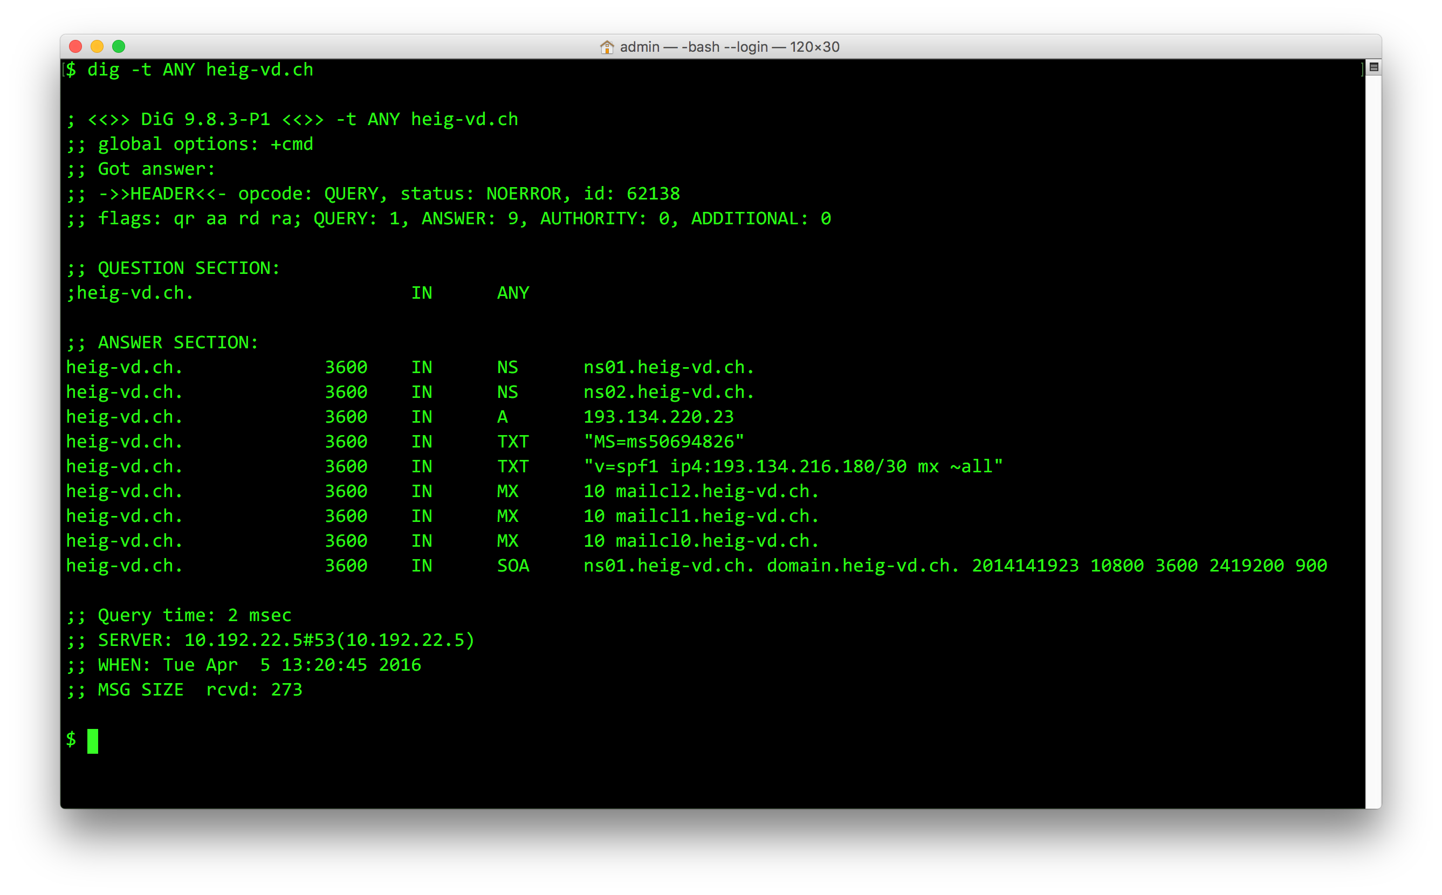
dig -t ANY heig-vd.ch
MX records point to the SMTP servers for the domain

Slide 15
In the last step, Alice’s MUA uses another protocol (e.g. IMAP, POP3) to fetch mails from the mailbox.
SMTP
587
IMAP/POP3
SMTP
25

Slide 16

Let’s be human Exchange Servers (and play the role of Bob’s MTA).
But instead of forwarding the mail to gmail, let’s forward the mail via the HEIG-VD’s SMTP server.

Slide 17
dig -t MX heig-vd.ch
heig-vd.ch. 600 IN MX 10 mail01.heig-vd.ch.
telnet mailcl0.heig-vd.ch 25
openssl s_client -starttls smtp -crlf -connect mail01.heig-vd.ch:25 (or use 465)
EHLO mycompany.com

Slide 18
$ telnet mailcl10.heig-vd.ch 25
mailcl10.heig-vd.ch: nodename nor servname provided, or not known
$ telnet mailcl0.heig-vd.ch 25
Trying 193.134.216.181...
Connected to mailcl0.heig-vd.ch.
Escape character is '^]'.
220 heig-vd.ch ESMTP MailCleaner (Enterprise Edition 2016.01) Tue, 05 Apr 2016 14:18:24 +0200
EHLO mycompany.com
250-heig-vd.ch Hello mbp-de-admin.einet.ad.eivd.ch [10.192.116.92]
250-SIZE 20480000
250-8BITMIME
250-PIPELINING
250-AUTH PLAIN LOGIN
250-STARTTLS
250 HELP
MAIL FROM: bob@bob.com
250 OK
RCPT TO: olivier.liechti@wasabi-tech.com
250 Accepted
DATA
354 Enter message, ending with "." on a line by itself
From: bob@areyousure.com
To: olivier.liechti@wasabi-tech.com
Subject: demo
Ok. Cool. Bye.
.
250 OK id=1anPx9-0003KC-BC
quit
221 heig-vd.ch closing connection
Connection closed by foreign host.
SMTP command
!=
Message header

Slide 19

The Specs

Slide 20
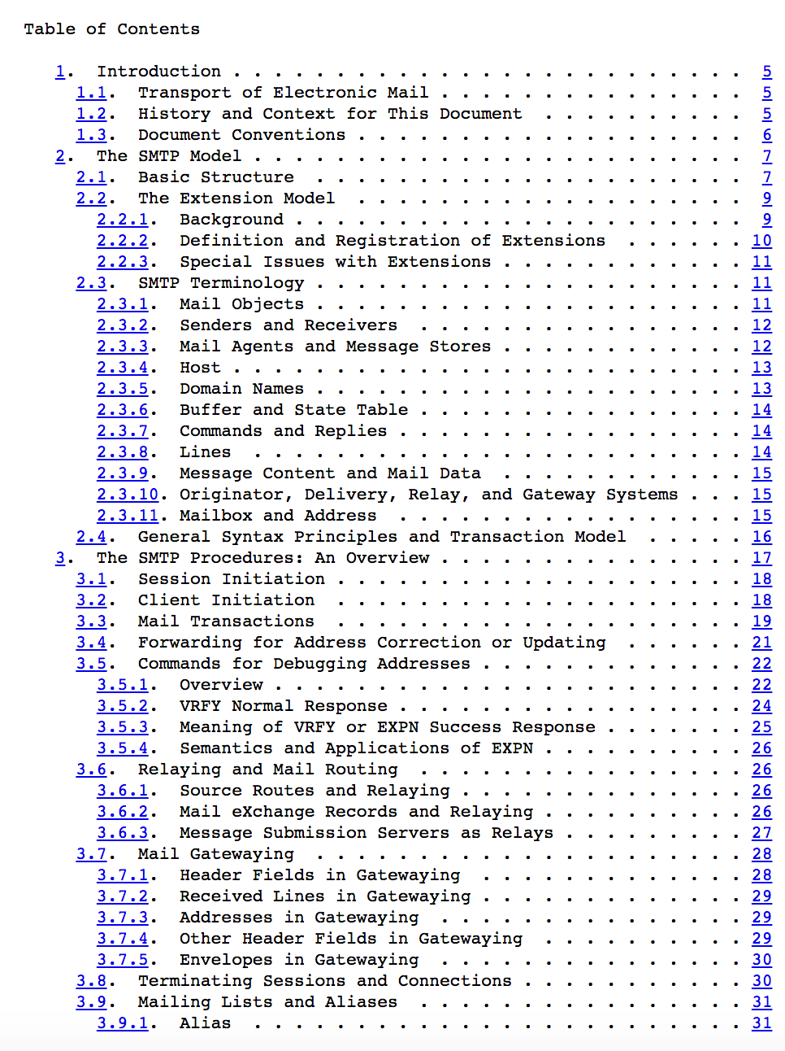
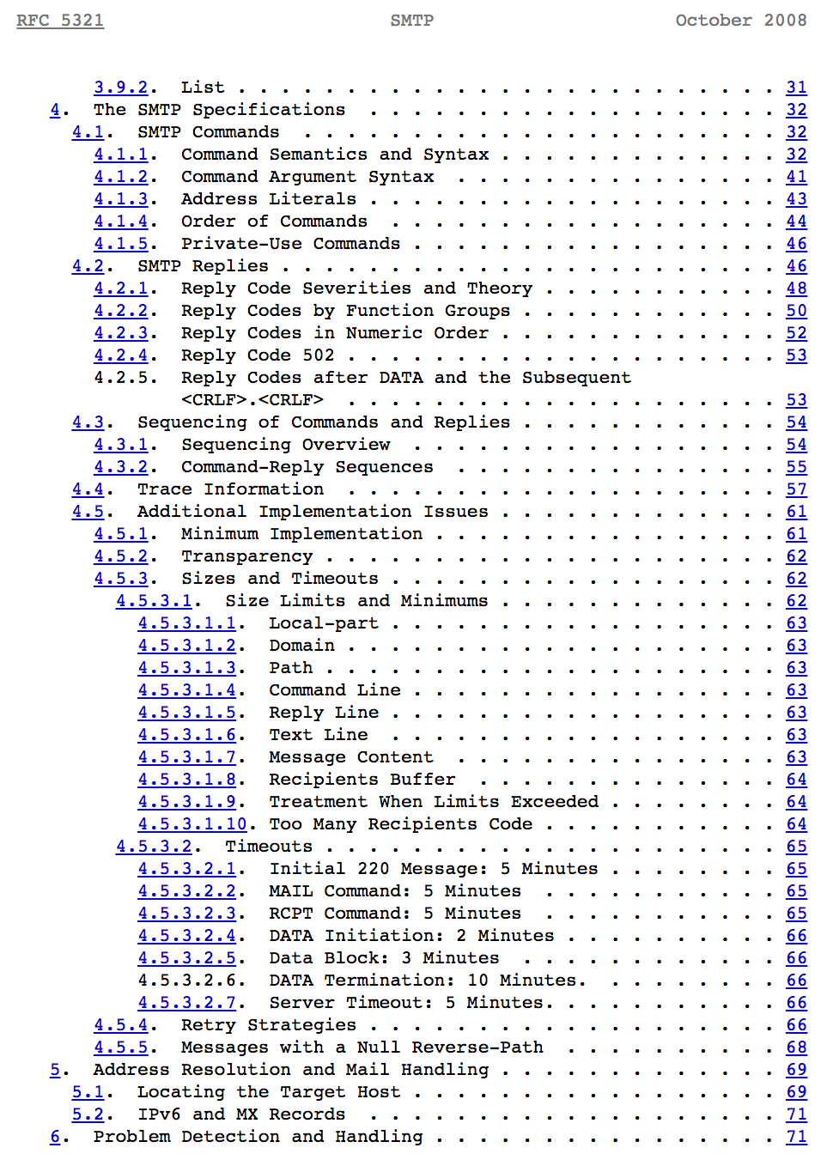
https://tools.ietf.org/html/rfc5321

Slide 21
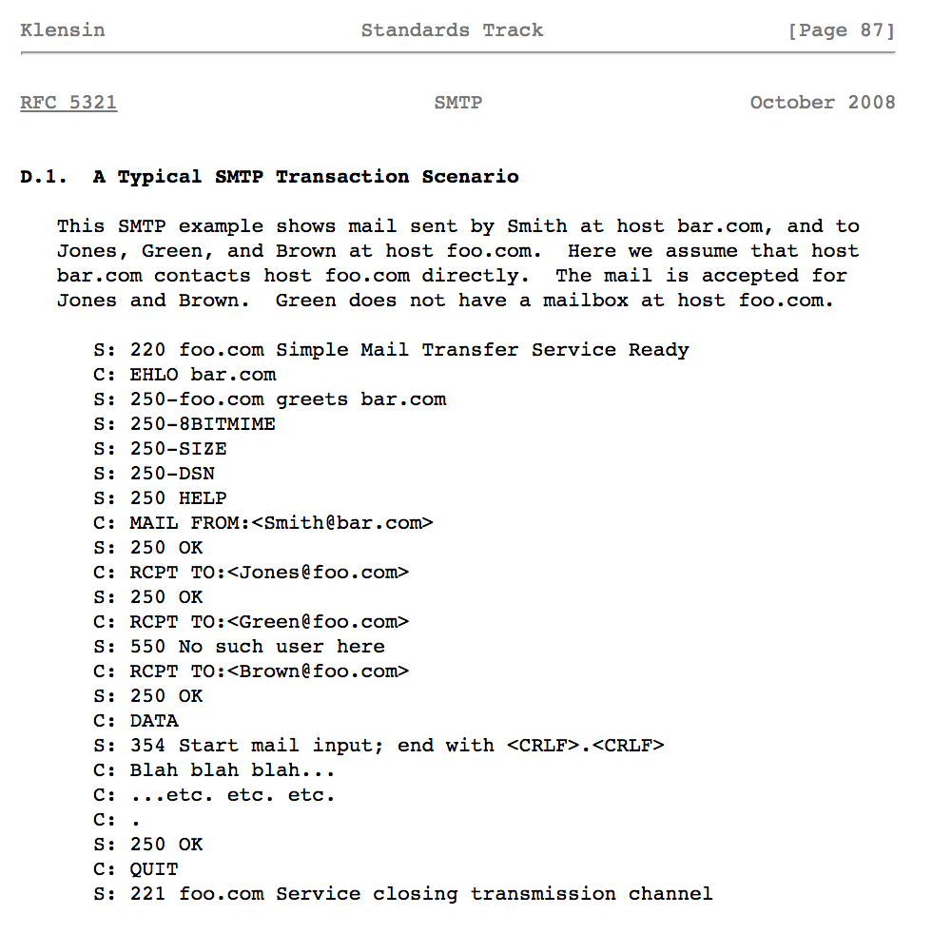
https://tools.ietf.org/html/rfc5321

Slide 22

SMTP Servers for experiments

Slide 23
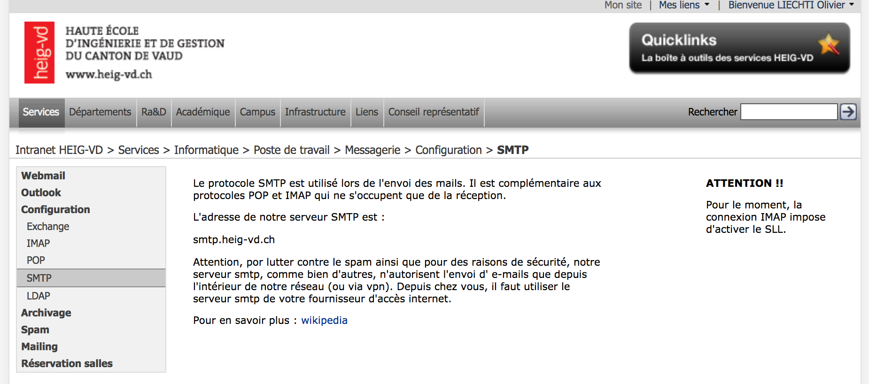

Slide 24

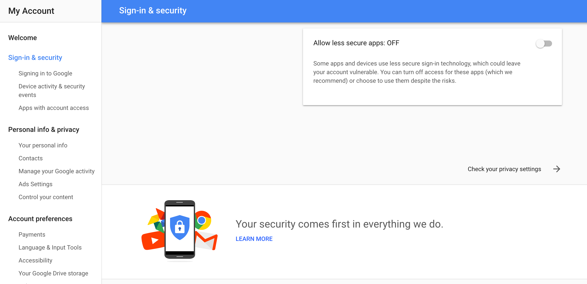
With this default setup, you will not be able to login with your user id / password.

Slide 25


Slide 26
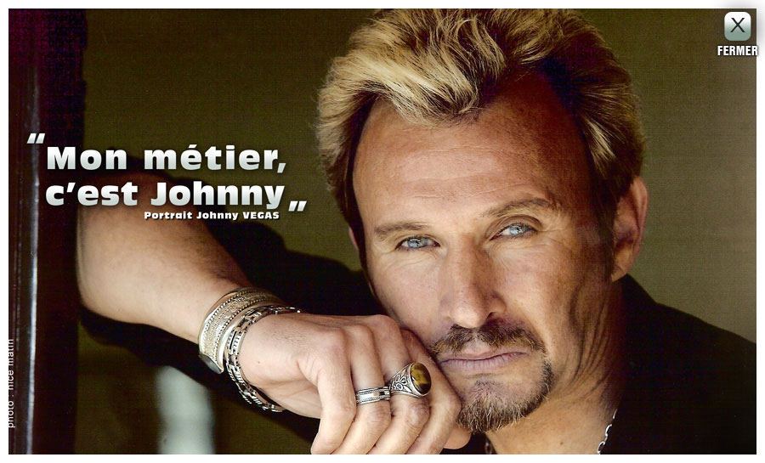
Mock Servers

Slide 27
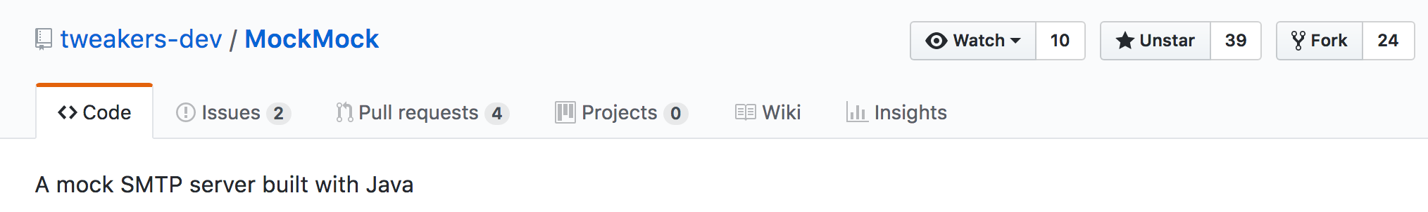
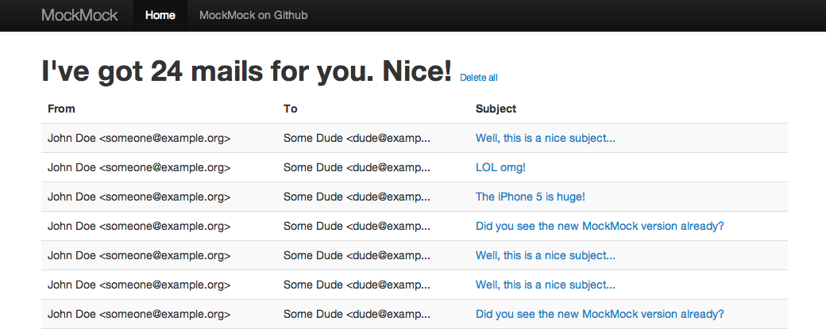

Slide 28


